Slide 1
Programming in C

Slide 2
Module 5.1:
Pointers

Slide 3
Pointers
Introduction to pointers: Pointer declaration and initialization, Pointer addition and subtraction, Evaluating pointer expressions
Pointers and Functions: Pass by Reference, Returning pointers from functions

Slide 4
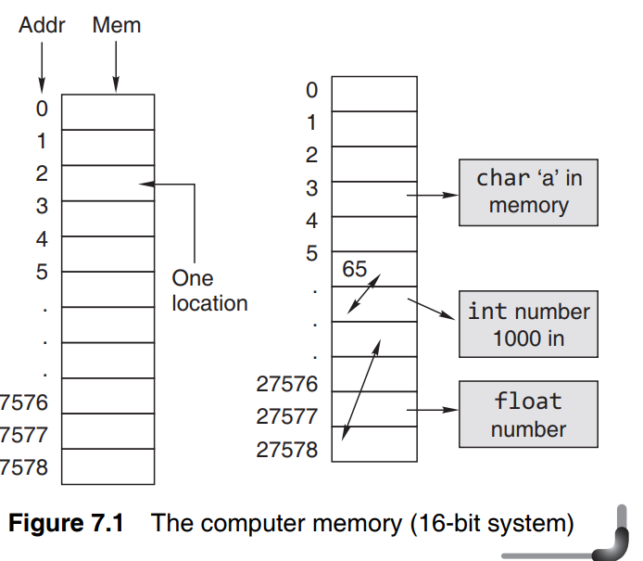
Pointers
Address in C:
If you have a variable var in your program, &var will give you its address in the memory. We have used address numerous times while using the scanf() function.
#include <stdio.h>
int main()
{
int var = 10;
printf("var: %d\n", var);
// Notice the use of & before var
printf("address of var: %x", &var);
return 0;
}

Slide 5
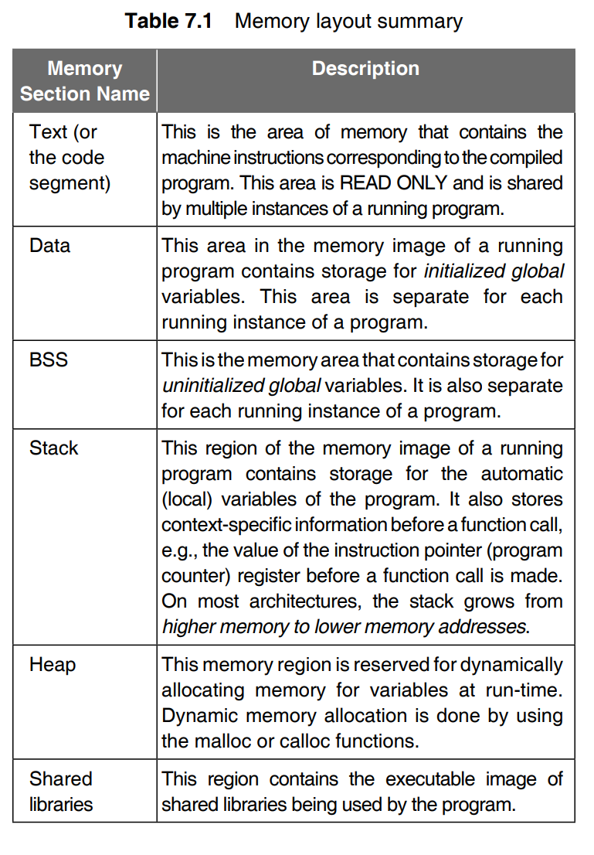
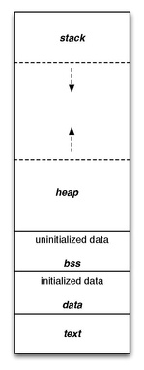
block starting symbol (BSS)
This shows the typical layout of a simple computer's program memory with the text, various data, and stack and heap sections.

Slide 6
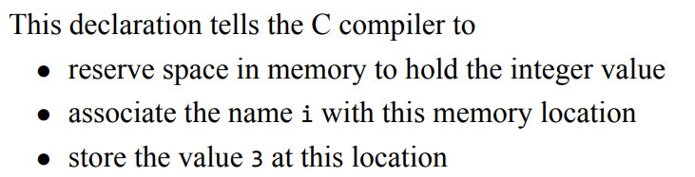
Pointers
Address in C:
If you have a variable i in your program, &i will give you its address in the memory. We have used the address numerous times while using the scanf() function.
#include <stdio.h> Output:
int main() i: 3
{ address of i: 2686778
int i = 3; Note: You will probably get a different
printf(“i: %d\n", i); address when you run the code.
// Notice the use of & before var
printf("address of i: %p %x %u %d", &i, &i, &i, &i);
return 0;
}

Slide 7
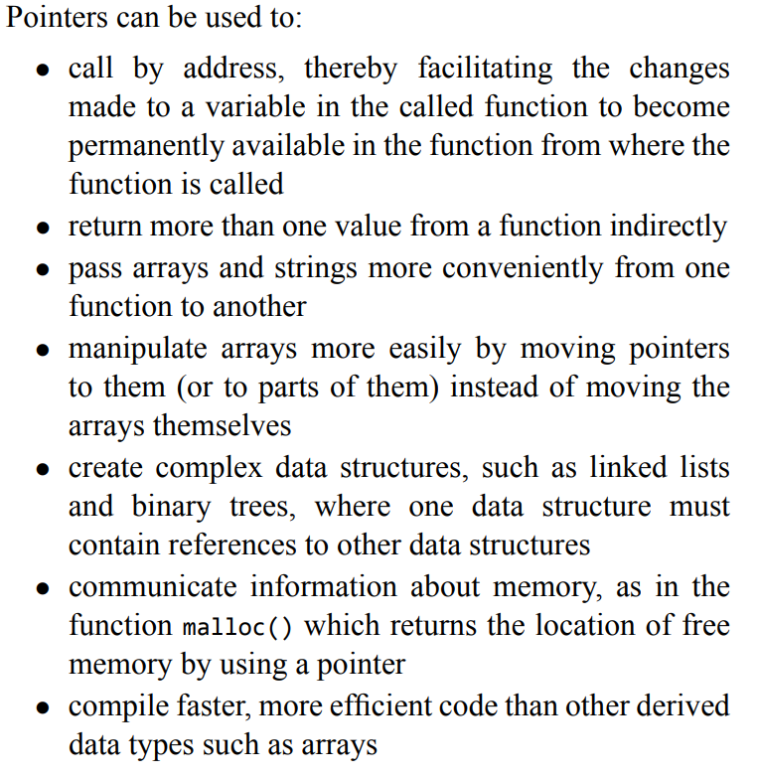

Slide 8
Pointers
A pointer is a variable whose value is the address of another variable, i.e., direct address of the memory location.
Pointers (pointer variables) are special variables that are used to store addresses rather than values.
Pointer Syntax
int *p1;
int * p2;
int* p1, p2;
Here p1 is pointer and p2 is normal variable

Slide 9
Pointers
The general form of a pointer variable declaration is −
type *var-name;
Here, type is the pointer's base type; it must be a valid C data type and var-name is the name of the pointer variable. Take a look at some of the valid pointer declarations −
int *ip; /* pointer to an integer */
double *dp; /* pointer to a double */
float *fp; /* pointer to a float */
char *ch /* pointer to a character */
The actual data type of the value of all pointers, whether integer, float, character, or otherwise, is the same, a long hexadecimal number that represents a memory address. The only difference between pointers of different data types is the data type of the variable or constant that the pointer points to.

Slide 10
Pointers
Assigning addresses to Pointers
int* pc, c;
c = 5;
pc = &c;
Here, 5 is assigned to the c variable. And, the address of c is assigned to the pc pointer.

Slide 11
Pointers
Get Value of variable Pointed by Pointers
To get the value of the thing pointed by the pointers, we use the * operator. For example:
int* pc, c; c =5 pc : address of c pc =&c
c = 5;
pc = &c;
printf("%d\n", *pc);
Here, the address of c is assigned to the pc pointer. To get the value stored in that address, we used *pc.
Note: In the above example, pc is a pointer, not *pc. You cannot and should not do something like *pc = &c;
By the way, * is called the dereference operator (when working with pointers). It operates on a pointer and gives the value stored in that pointer.
Pointer1.c

Slide 12
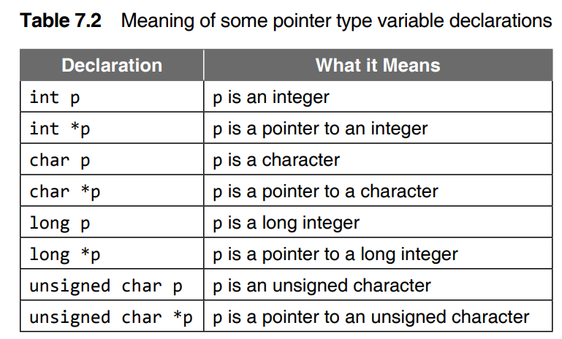
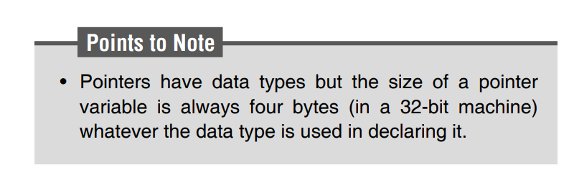
Pointer2.c

Slide 13
Pointers
Changing values pointed by pointers
Int *pc, c;
c = 5;
pc = &c;
c = 1;
printf("%d\n", c);
printf("%d\n", *pc);

Slide 14
Pointers
Changing values pointed by pointers
int* pc, c;
c = 5;
pc = &c;
c = 1;
printf("%d\n", c); // Output: 1
printf("%d\n", *pc); // Ouptut: 1
int* pc, c;
c = 5;
pc = &c;
*pc = 1;
printf("%d\n", *pc);
printf("%d\n", c);

Slide 15
Pointers
Changing values pointed by pointers
int* pc, c;
c = 5;
pc = &c;
c = 1;
printf("%d\n", c); // Output: 1
printf("%d\n", *pc); // Ouptut: 1
int* pc, c;
c = 5;
pc = &c;
*pc = 1;
printf("%d\n", *pc); // Ouptut: 1
printf("%d\n", c); // Output: 1
int* pc, c, d;
c = 5;
d = -15;
pc = &c; printf("%d\n", *pc);
pc = &d; printf("%d\n", *pc);

Slide 16
Pointers
Changing values pointed by pointers
Int *pc, c;
c = 5;
pc = &c;
c = 1;
printf("%d\n", c); // Output: 1
printf("%d\n", *pc); // Ouptut: 1
Int *pc, c;
c = 5;
pc = &c;
*pc = 1;
printf("%d\n", *pc); // Ouptut: 1
printf("%d\n", c); // Output: 1
Int *pc, c, d;
c = 5;
d = -15;
pc = &c; printf("%d\n", *pc); // Output: 5
pc = &d; printf("%d\n", *pc); // Ouptut: -15

Slide 17
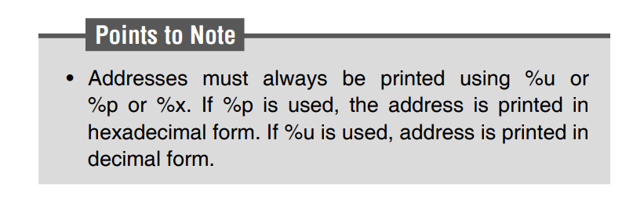
Pointers
Changing values pointed by pointers
#include <stdio.h>
int main()
{ int* pc, c;
c = 22;
printf("Address of c: %p\n", &c);
printf("Address of pc: %p\n", &pc);
printf("Value of c: %d\n\n", c);
pc = &c;
printf("Address of pointer pc: %p\n", pc);
printf("Content of pointer pc: %d\n\n", *pc);
c = 11; USE %x instead of %p and chk the displayed ouput.
USE of %x and %u is done frequently.
printf("Address of pointer pc: %p\n", pc);
printf("Content of pointer pc: %d\n\n", *pc);
*pc = 2;
printf("Address of c: %p\n", &c);
printf("Value of c: %d\n\n", c);
return 0; }
Pointer3.c

Slide 18
Pointers
Common mistakes when working with pointers
int c, *pc;
// pc is address but c is not
pc = c; // Error
// &c is address but *pc is not
*pc = &c; // Error
// both &c and pc are addresses
pc = &c;
// both c and *pc values
*pc = c;

Slide 19
Pointers
Here's an example of pointer syntax beginners often find confusing.
#include <stdio.h>
int main()
{
int c = 5;
int *p = &c;
printf("%d", *p); // 5
return 0;
}

Slide 20
Pointers
Here's an example of pointer syntax beginners often find confusing.
#include <stdio.h>
int main()
{
int c = 5;
int *p = &c;
printf("%d", *p); // 5
return 0;
}
Why didn't we get an error when using int *p = &c;?
It's because
int *p = &c;
is equivalent to
int *p:
p = &c;
In both cases, we are creating a pointer p (not *p) and assigning &c to it.
To avoid this confusion, we can use the statement like this:
int* p = &c;

Slide 21
Pointers
NULL Pointers
It is always a good practice to assign a NULL value to a pointer variable in case you do not have an exact address to be assigned. This is done at the time of variable declaration. A pointer that is assigned NULL is called a null pointer.
#include <stdio.h>
int main () {
int *ptr = NULL;
printf("The value of ptr is : %x\n", ptr );
return 0;
}

Slide 22
Pointers
NULL Pointers
It is always a good practice to assign a NULL value to a pointer variable in case you do not have an exact address to be assigned. This is done at the time of variable declaration. A pointer that is assigned NULL is called a null pointer.
#include <stdio.h>
int main () { output:
int *ptr = NULL; The value of ptr is : 0
printf("The value of ptr is : %x\n", ptr );
return 0;
}

Slide 23
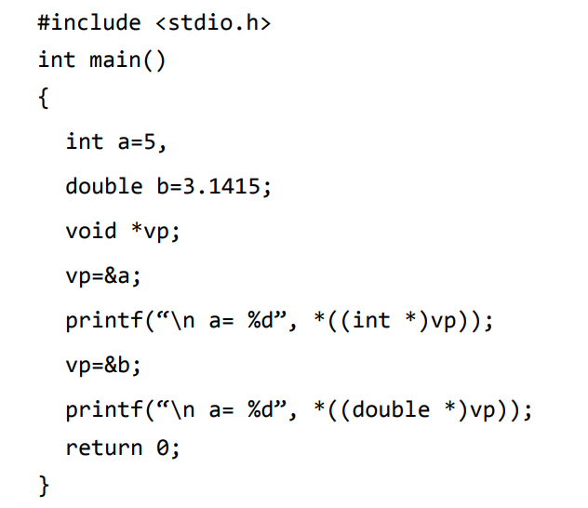
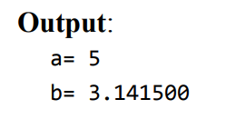
A void pointer is a special type of pointer.
It can point to any data type, from an integer value or a float to a string of characters.
Its sole limitation is that the pointed data cannot be referenced directly (the asterisk * operator cannot be used on them) since its length is always undetermined.
Therefore, type casting or assignment must be used to turn the void pointer to a pointer of a concrete data type to which we can refer.

Slide 24
To test it for a null pointer before inspecting the value pointed to, code such as the following can be used.
if(ip != NULL)
printf(“%d\n”, *ip);
It is also possible to refer to the null pointer using a constant 0, and to set null pointers by simply saying
int *ip = 0;
Furthermore, since the definition of ‘true’ in C is a value that is not equal to 0, the following statement tests for nonnull pointers with abbreviated code such as
if(ip)
printf(“%d\n”, *ip);
This has the same meaning as our previous example;
if(ip) is equivalent to if(ip != 0) and to if(ip != NULL).
The value 0 can be used to represent a null pointer in
(1)assignment and initialization, (2) comparison.
All of these uses are legal, although the use of the constant NULL is recommended for clarity.

Slide 25
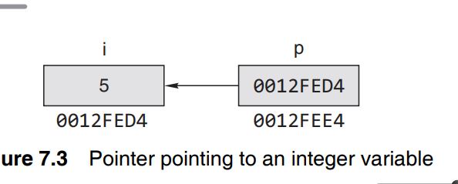
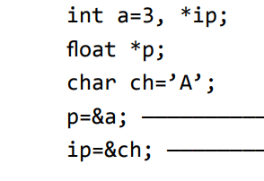

a. What is the meaning of this ?
b.

Slide 26
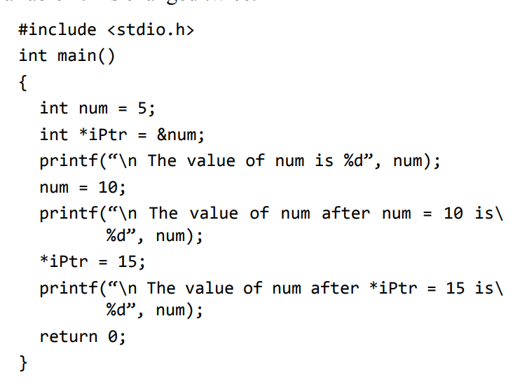

Slide 27
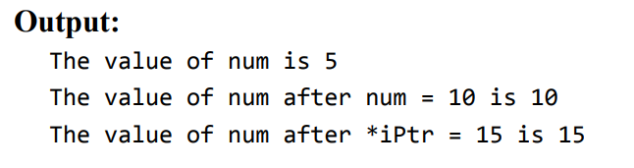

Slide 28
Functions
Function Calls, Passing Arguments to a Function by Value
1) Function – Call by value method – In the call by value method the actual arguments are copied to the formal arguments, hence any operation performed by function on arguments doesn’t affect actual parameters.
2) Function – Call by reference method – Unlike call by value, in this method, address of actual arguments (or parameters) is passed to the formal parameters, which means any operation performed on formal parameters affects the value of actual parameters.

Slide 29
Functions
Function – Call by value method
Actual parameters: The parameters that appear in function calls.
(eg.var1, var2)
Formal parameters: The parameters that appear in function declarations.
(num1, num2)
What is Function Call By value?
When we pass the actual parameters while calling a function then this is known as function call by value. In this case the values of actual parameters are copied to the formal parameters. Thus operations performed on the formal parameters don’t reflect in the actual parameters.

Slide 30
Functions
Function – Call by value method
#include <stdio.h>
int increment(int var)
{
var = var+1;
return var;
}
int main()
{
int num1=20;
int num2 = increment(num1);
printf("num1 value is: %d", num1);
printf("\nnum2 value is: %d", num2);
return 0;
}
Output: ?

Slide 31
Functions
Function – Call by value method
#include <stdio.h>
int increment(int var)
{
var = var+1;
return var;
}
int main()
{
int num1=20;
int num2 = increment(num1);
printf("num1 value is: %d", num1);
printf("\nnum2 value is: %d", num2);
return 0;
}
Output:
num1 value is: 20
num2 value is: 21

Slide 32
Functions
Swapping numbers using Function Call by Value
#include <stdio.h>
void swapnum( int var1, int var2 )
{
int tempnum ;
tempnum = var1 ;
var1 = var2 ;
var2 = tempnum ;
}
int main( )
{
int num1 = 35, num2 = 45 ;
printf("Before swapping: %d, %d", num1, num2);
/*calling swap function*/
swapnum(num1, num2);
printf("\nAfter swapping: %d, %d", num1, num2);
}
Output:?

Slide 33
Functions
Swapping numbers using Function Call by Value
#include <stdio.h>
void swapnum( int var1, int var2 )
{
int tempnum ;
tempnum = var1 ;
var1 = var2 ;
var2 = tempnum ;
}
int main( )
{
int num1 = 35, num2 = 45 ;
printf("Before swapping: %d, %d", num1, num2);
/*calling swap function*/
swapnum(num1, num2);
printf("\nAfter swapping: %d, %d", num1, num2);
}
Output:
Before swapping: 35, 45
After swapping: 35, 45
The reason is – function is called by value for num1 & num2. So actually var1 and var2 gets swapped (not num1 & num2). As in call by value actual parameters are just copied into the formal parameters.

Slide 34
Functions
Function – Call by reference method
Actual parameters: The parameters that appear in function calls.
(eg.var1, var2)
Formal parameters: The parameters that appear in function declarations.
(num1, num2)
What is Function Call By value?
Unlike call by value, in this method, address of actual arguments (or parameters) is passed to the formal parameters, which means any operation performed on formal parameters affects the value of actual parameters.

Slide 35
Functions
Swapping numbers using Function Call by reference/ Pass Addresses to Functions
#include <stdio.h>
int swapnum ( int *var1, int *var2 )
{
int tempnum ;
tempnum = *var1 ;
*var1 = *var2 ;
*var2 = tempnum ;
}
int main( )
{
int num1 = 35, num2 = 45 ;
printf("Before swapping:");
printf("\nnum1 value is %d", num1);
printf("\nnum2 value is %d", num2);
/*calling swap function*/
swapnum( &num1, &num2 );
printf("\nAfter swapping:");
printf("\nnum1 value is %d", num1);
printf("\nnum2 value is %d", num2);
return 0;
}
Output:
Before swapping:
num1 value is 35
num2 value is 45
After swapping:
num1 value is 45
num2 value is 35
The values of the variables have been changed after calling the swapnum() function because the swap happened on the addresses of the variables num1 and num2.

Slide 36
Pointers
Swapping numbers using Function Call by reference/ Pass Addresses to Functions
#include <stdio.h>
int swapnum ( int *var1, int *var2 )
{
int tempnum ;
tempnum = *var1 ;
*var1 = *var2 ;
*var2 = tempnum ;
}
int main( )
{
int num1 = 35, num2 = 45 ;
printf("Before swapping:");
printf("\nnum1 value is %d", num1);
printf("\nnum2 value is %d", num2);
/*calling swap function*/
swapnum( &num1, &num2 );
printf("\nAfter swapping:");
printf("\nnum1 value is %d", num1);
printf("\nnum2 value is %d", num2);
return 0;
}
The address of num1 and num2 are passed to the swap() function using swapnum(&num1, &num2);.
Pointers var1 and var2 accept these arguments in the function definition.
When *var1 and *var2 are changed inside the swap() function, num1 and num2 inside the main() function are also changed.
Inside the swap() function, *var1 and *var2 swapped. Hence, num1 and num2 are also swapped.

Slide 37
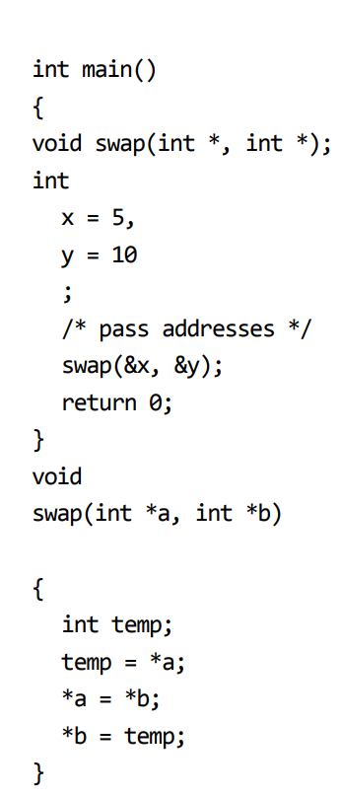

Slide 38
Pointers
Passing Pointers to Functions
#include <stdio.h>
void addOne(int* ptr) {
(*ptr)++; // adding 1 to *ptr
}
int main()
{
int* p, i = 10;
p = &i;
addOne(p);
printf("%d", *p);
return 0;
}
Here, the value stored at p, *p, is 10 initially.
We then passed the pointer p to the addOne() function. The ptr pointer gets this address in the addOne() function.
Inside the function, we increased the value stored at ptr by 1 using (*ptr)++;. Since ptr and p pointers both have the same address, *p inside main() is also 11.

Slide 39
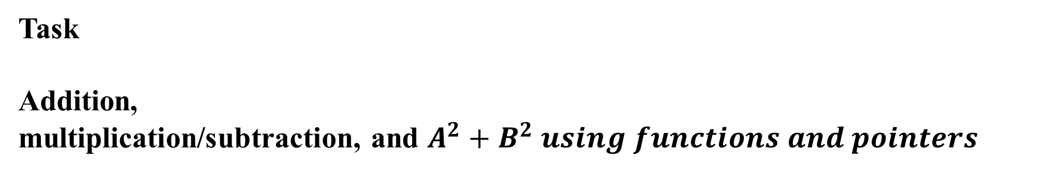
Pointers and Functions
Task
Addition,
multiplication/subtraction, and $A^{2}+B^{2} using functions and pointers$
Pointer4.c
Pointer5_stringlength.c

Slide 40
Pointers and Functions
#include <stdio.h>
int swapnum ( int *var1, int *var2 )
{​​
//int tempnum ;
int sum=0;
sum = *var1 + *var2;
return sum;
}​​
int main( )
{​​
int num1 = 5, num2 = 2 , sum1=0;
printf("Before addition:");
printf("\nnum1 value is %d", num1);
printf("\nnum2 value is %d", num2); /*calling swap function*/
sum1=swapnum( &num1, &num2 ); printf("\nAfter Addition:");
printf("\nSum value is %d", sum1);
//printf("\nnum2 value is %d", num2);
return 0;
}​​

Slide 41
Pointers and Functions
#include <stdio.h>
int add(int *n1,int *n2){​​
int res;
res= *n1 + *n2;
return res;
}​​
int sub(int *n1,int *n2){​​
int res;
res=*n1-*n2;
return res;
}​​
int func(int *n1,int *n2){​​
int res;
res=(((*n1)*(*n1))-(*n2)*(*n2));
return res;
}​​
int main(){​​
int a,b;
printf("Enter numbers:");
scanf("%d%d",&a,&b);
printf("\nAddition of %d %d is %d",a,b,add(&a,&b));
printf("\nSubtraction of %d %d is %d",a,b,sub(&a,&b));
printf("\nA^2+B^2 of %d %d is %d",a,b,func(&a,&b));
}​​

Slide 42
Differences between Array Name and Pointer
int a[5]={1,2,3,4,5};
int b[5];
b = a; /* WRONG */
#include <stdio.h>
int main()
{
int i;
fl oat *ptr, a[5];
ptr = a;
for(i = 0; i < 5; i++)
{
*ptr = 0.0; /* *ptr accesses a[i] */
ptr++;
}
return 0;
}
for(i=0; i<5; i++)
b[i]=a[i]; /*Correct*/
for(i=0; i<5; b[i]=a[i], i++); /*Correct */
Here two pointer variables can be assigned.
int *p1, *p2;
int a[10]={1,2,3,4,5};
p1 = &a[0];
p2 = p1;

Slide 43
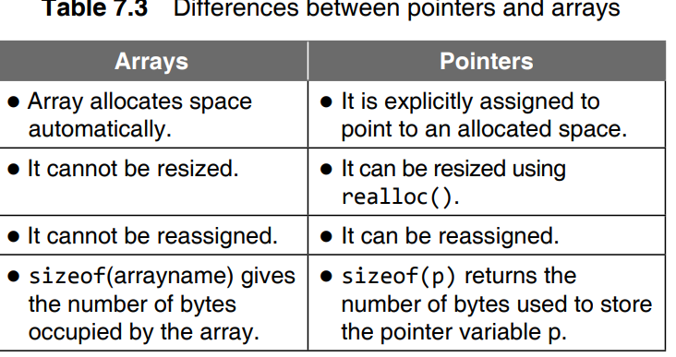

Slide 44
A string constant, like an array name by itself, is treated by the compiler as a pointer. Its value is the base address of the string. Like the numeric array, individual characters contained in a string can be printed.
#include <stdio.h>
int main()
{
char s[]=“Oxford”;
for(i=0;s[i]!=‘\0’;++i)
putchar(s[i]);
return 0;
}
A string in C is a pointer itself.
#include <stdio.h>
int main()
{ for(i=0;*(“I am a pointer” + i)!=‘\0’;++i)
printf(“%c”,*(“I am a pointer” + i));
return 0; }

Slide 45
#include <stdio.h>
int main()
{
int i=5;
int *ip;
void *vp;
ip = &i;
vp = ip;
//printf(“\n *vp= %d”,*vp);…. ERROR
ip = vp;
printf(“\n *ip= %d”,*ip);
return 0;
}
#include <stdio.h>
int main()
{
int i=5;
int *ip;
void *vp;
ip = &i;
vp = ip;
printf(“\n *vp= %d”,*((int *)vp));
ip = vp;
printf(“\n *ip= %d”,*ip);
return 0;
}
Output:
*vp=5
*ip=5
Compare two programs…..

Slide 46
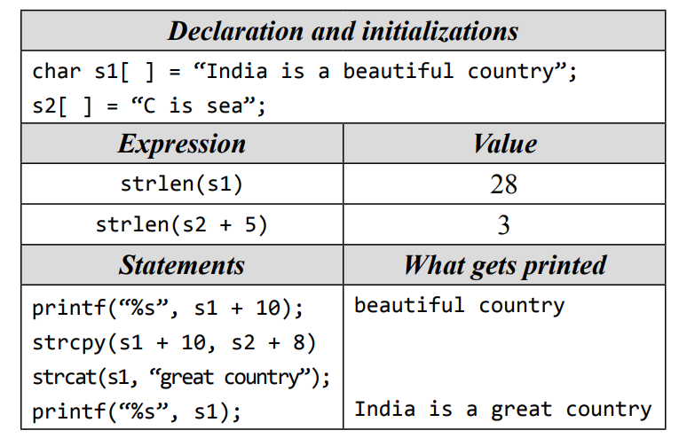

Slide 47
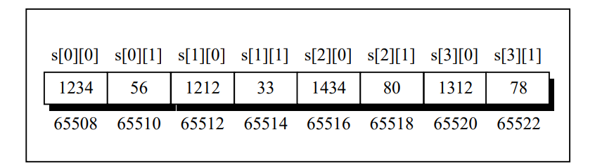
Discuss….ArrayPointer_2ndApril..notepad
we want to refer to the element s[2][1] using pointers.
We know (from the above program) that s[2] would give the address 65516, the address of the second one-dimensional array.
Obviously ( 65516 + 1 ) would give the address 65518. Or
( s[2] + 1 ) would give the address 65518. And
the value at this address can be obtained by using the value at address operator, saying *( s[2] + 1 ).
But, we have already studied while learning one-dimensional arrays that num[i] is same as *( num + i ).
Similarly, *( s[2] + 1 ) is same as, *( *( s + 2 ) + 1 ).
Thus, all the following expressions refer to the same element,
s[2][1]
* ( s[2] + 1 )
* ( * ( s + 2 ) + 1 )

Slide 48
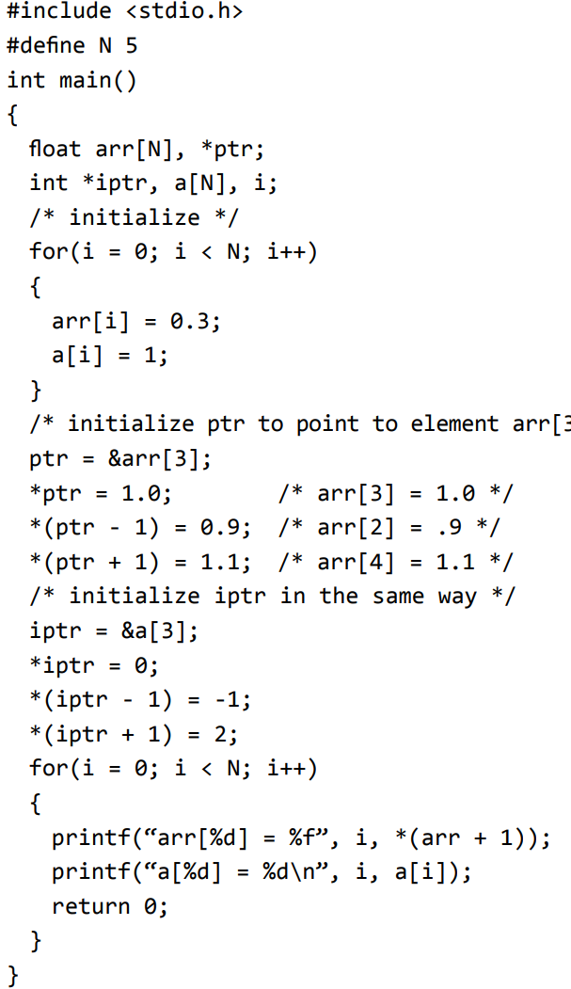
Output ?
*((ptr-3) + i)

Slide 49
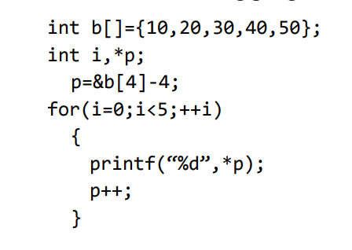
Output?

Slide 50
2D array and pointers
int main( )
{
int s[4][2] = { { 1234, 56 }, { 1212, 33 }, { 1434, 80 }, { 1312, 78 } } ;
int i ,j ;
for ( i = 0 ; i <= 3 ; i++ )
for (j=0;j<=1;j++)
printf ( "\nAddress of % d %d %d th 2-D array = %u",i, j, *(*(i+s)+j),&(s[i][j]) ) ;
return 0;
}
Output:
Value and Address of i=0, j=0 value=1234 2-D array address =6422000
Value and Address of i=0, j=1 value=56 2-D array address =6422004
Value and Address of i=1, j=0 value=1212 2-D array address =6422008
Value and Address of i=1, j=1 value=33 2-D array address =6422012
Value and Address of i=2, j=0 value=1434 2-D array address =6422016
Value and Address of i=2, j=1 value=80 2-D array address =6422020
Value and Address of i=3, j=0 value=1312 2-D array address =6422024
Value and Address of i=3, j=1 value=78 2-D array address =6422028

Slide 51
main( )
{ static int a[ ] = { 55, 9, 2, 3, 4 } ;
int *p[ ] = { a, a + 1, a + 2, a + 3, a + 4 } ;
printf ( "\n%u %u %d", p, *p, * ( *p ) ) ; }
Output?
6422000 4206608 55

Slide 52
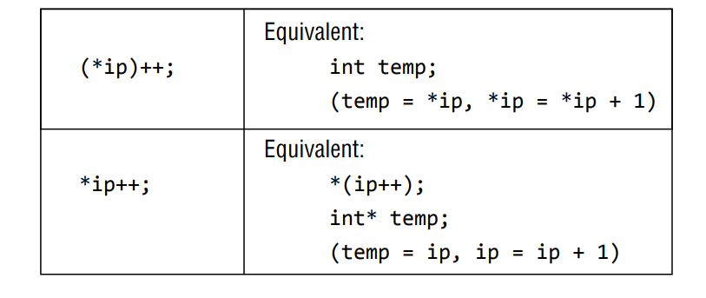

Slide 53
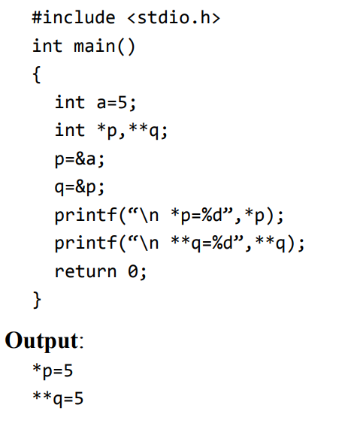
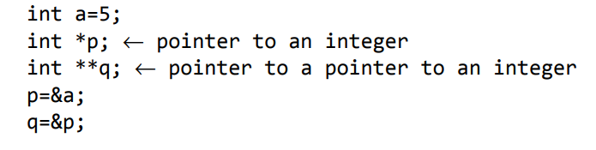
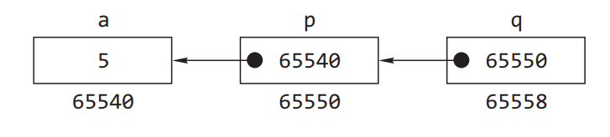
Pointers to Pointers

Slide 54


ptr2arr here is a pointer to an array of 10 integers just as it was under the declaration using the array type. Note that this is different from
which would make ptr2arr the name of an array of 10
pointers to type int.
. int main()
{
int a[2][3]={{3,4,5},{6,7,8}};
int i; int(*pa)[3];
pa=a;
for(i=0;i<3;++i)
printf(“%d\t”,(*pa)[i]);
printf(“\n”);
pa++;
for(i=0;i<3;++i)
printf(“%d\t”,(*pa)[i]);
return 0;
}
Output:
3 4 5
6 7 8
The elements of a two-dimensional array can be printed using a pointer to an array.
The following program illustrates this.

Slide 55
a two-dimensional array can be expressed as follows:
a[i][j] = *(a[i]+ j) = (*(a + i))[j] = *(*(a + i) + j)

